Slide 1





Airbnb Investment Analysis in Istanbul
Evaluating Neighborhood Activity, Property Type Ratings, and Host Revenue
Made By: Abdul Qadeer

Slide 2
Problem Statement
Our client is exploring the opportunity to invest in an Airbnb property in Istanbul. Before committing, they need insights into:
Which neighborhoods are most active?
What property types are most appreciated by guests?
How much do successful hosts typically earn?

Slide 3
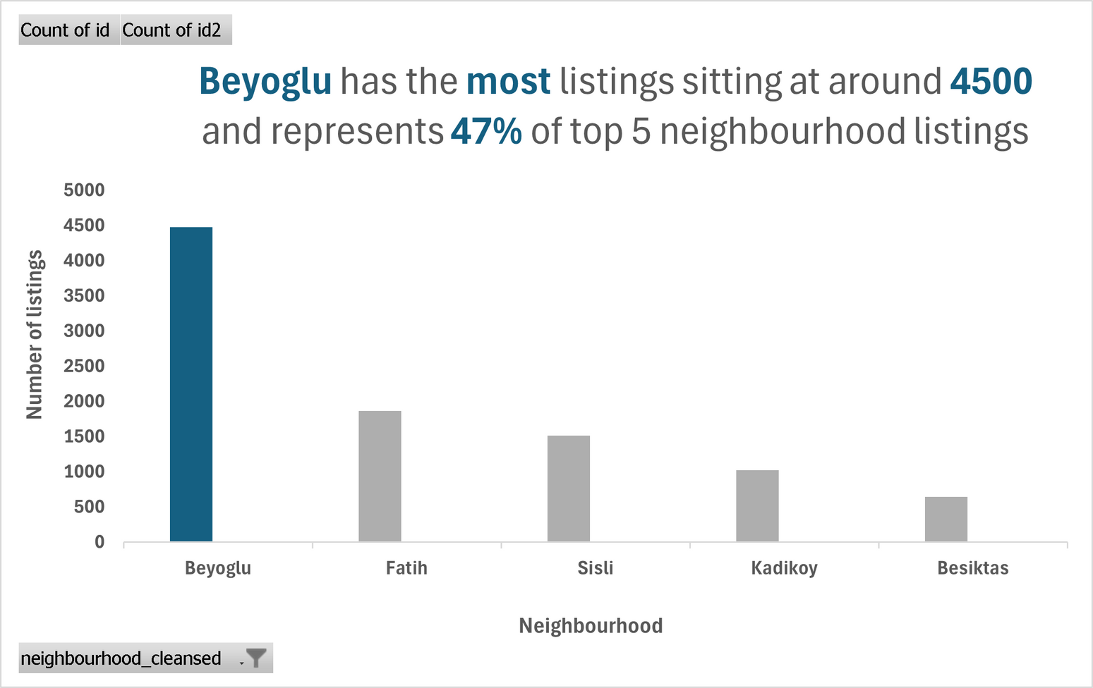
Q1 – Which Neighborhoods Have the Most Listings?
Beyoglu dominates the market with ~4500 listings, accounting for 47% of listings in the top 5 neighborhoods.
This suggests high demand and potential visibility for new properties in this area.

Slide 4
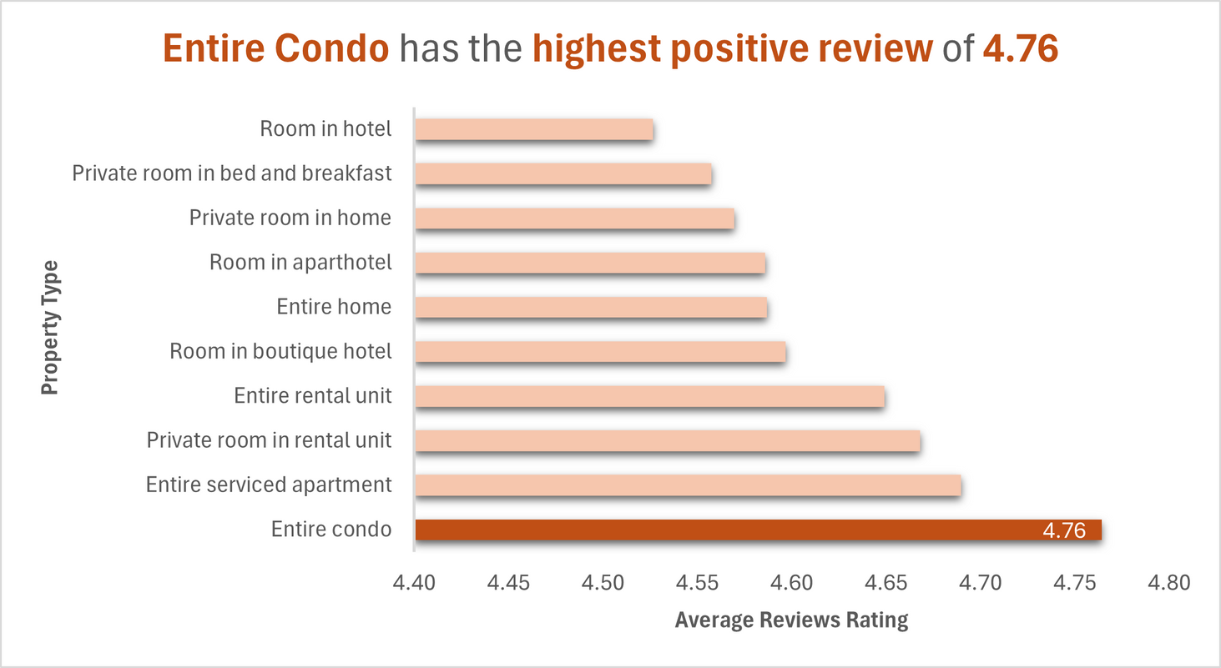
Q2 – What Property Types Get the Best Reviews?
Entire Condo receives the highest average review rating of 4.76.
Guests consistently rate this property type more positively than others.

Slide 5
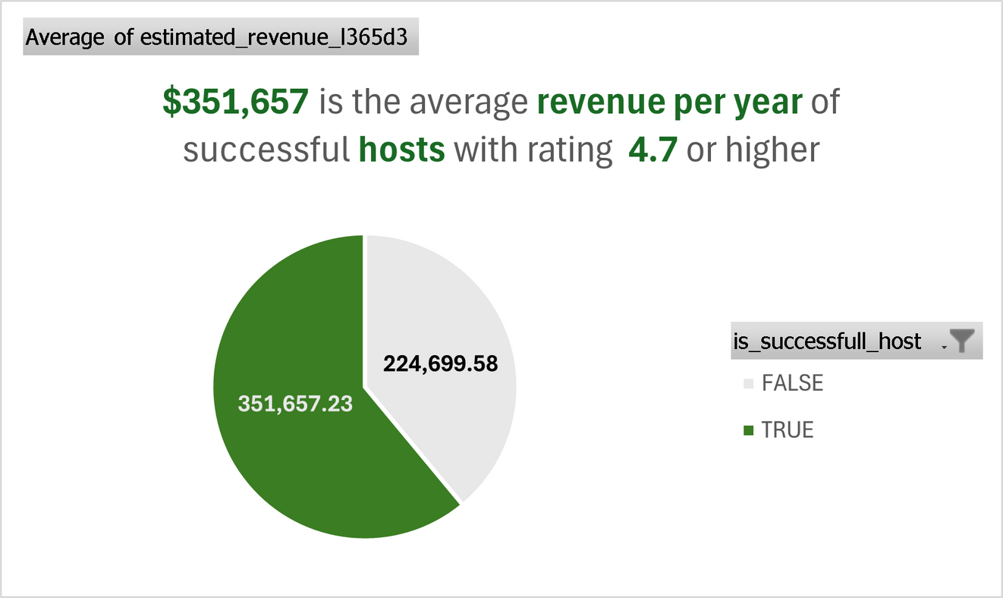
Q3 – How Much Revenue Do Successful Hosts Generate?
Successful hosts (with rating ≥ 4.7) earn an average of $351,657 per year
In contrast, others earn significantly less (~$224,700), proving that high-rated hosts generate better returns.

Slide 6


Final Recommendation
Should you invest in Airbnb in Istanbul?
Yes, here's what you should do:
01
Focus on Beyoglu, as it has the highest number of active listings, indicating strong market activity and demand.
02
Invest in an entire condo, which receives the most positive reviews among property types, reflecting higher guest satisfaction.
03
Prioritize listing quality and guest experience to maintain a review score of 4.7 or higher, as this significantly increases potential revenue for hosts.

Slide 7
Thank You!
Any questions?

